Slide 1
E-commerce Platform for Survey Equipment Rental
Mausham Dhakal

Slide 2
Project Overview and Objectives

Slide 3
Aims
To develop an intuitive online platform that allows customers to easily browse, select, and rent survey equipment based on their needs.
To implement technology that modernizes the equipment rental process, improving accessibility and efficiency for users.
To reduce administrative workload by automating processes, such as booking, payments, and customer communication, streamlining the rental procedure.
To provide an easy-to-use platform for independent surveyors and small businesses to find and rent survey equipment with minimal effort.
To minimize operational costs by reducing reliance on physical paperwork, in-person meetings, and manual transactions.
To enhance the overall user experience, ensuring that the rental process is quick, secure, and reliable, building customer trust and encouraging repeat business.

Slide 4
Objectives
Design and implement a user-friendly interface that allows customers to easily search, filter, and select survey equipment based on their requirements.
Ensure scalability of the platform, allowing it to handle an increasing number of users, equipment listings, and rental transactions as the business grows.
Develop a secure user authentication system that ensures the protection of user accounts, personal data, and payment information.
To implement a dynamic pricing model that adjusts the rental prices of survey equipment according to seasonal demand, offering competitive rates during peak and off-peak seasons to optimize revenue and attract more customers.

Slide 5
Artefact (Proposed) to be Developed
User Registration and Login
Browse and Filter Survey Equipment
View and Update Profile
Book Equipment
Dynamic Pricing System
Add to Cart:

Slide 6
Introduction
The demand for specialized survey equipment like total stations, drones, and GPS devices is rising, but high costs make ownership impractical for many surveyors and small businesses. This project aims to develop an e-commerce platform for renting survey equipment, providing a cost-effective and flexible solution. By streamlining the rental process with features such as dynamic pricing, easy booking, and secure payments, the platform ensures accessibility, reduces costs, and offers a user-friendly experience for both customers and administrators.

Slide 7
Problem Scenario
As a land surveyor in Nepal, I’ve faced many challenges in renting survey equipment, and other surveyors face similar issues. The process is often slow and unreliable, requiring visits to multiple rental shops and dealing with inconsistent pricing. Limited equipment availability causes delays, and high costs make it tough for small businesses and surveyors to access the tools they need.
This project aims to solve these issues by creating an online platform for renting survey equipment. The platform will make it easy for all surveyors in Nepal to browse, book, and rent tools with clear pricing and reliable availability, saving time and making the process more convenient for everyone.

Slide 8
Solution
Introducing an online platform
Transparent Pricing Structure
Reliable Equipment Access

Slide 9
Methodology
The Scrum methodology will be employed for the development of the Survey Equipment Rental Platform. Scrum is a widely adopted Agile framework that promotes iterative development, allowing teams to deliver incremental value at regular intervals. This approach is particularly suitable for our project because it offers a flexible and adaptive framework that accommodates changes in project scope, requirements, and priorities.

Slide 10
Tools and Techniques to be used
Frontend: React.js
Backend: Node.js
Database Management : Mongo DB
Design Tools : Figma
Project management Tools : ClickUp
Version Control : GitHub

Slide 11
Planned Testing
Unit Testing
Integration Testing
Usability Testing
Performance Testing
User Acceptance Testing

Slide 12
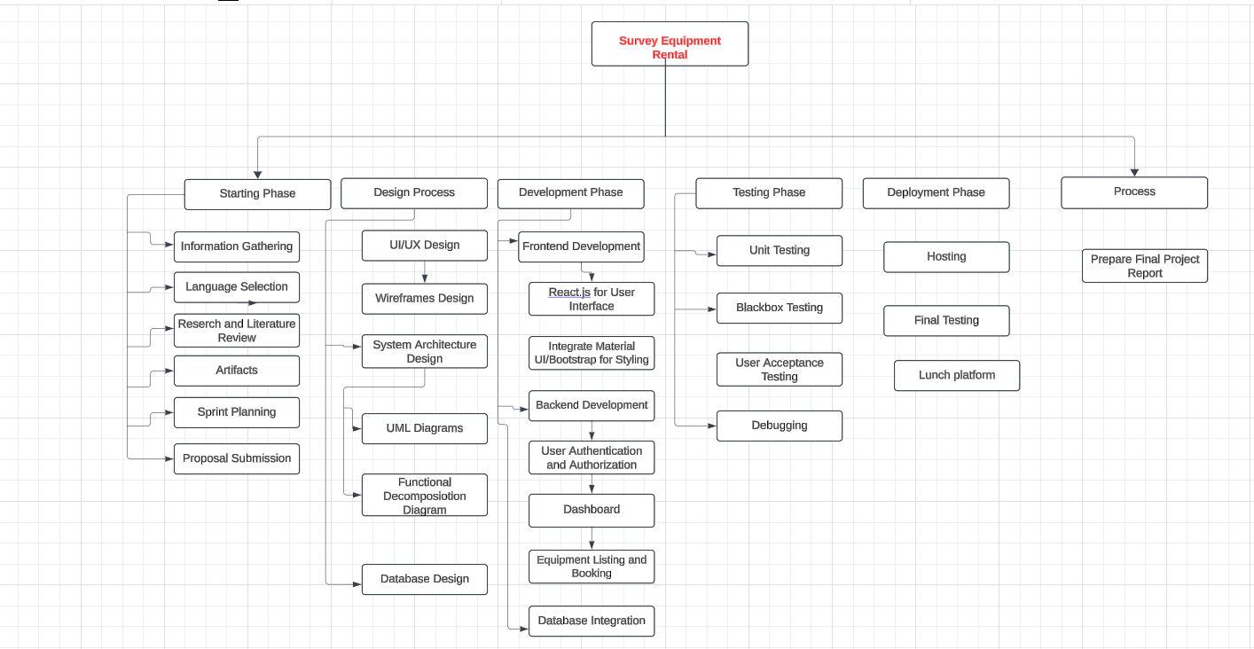
WBS

Slide 13
Thank You
Mausham Dhakal

